Slide 1

Organization Overview
Candice Dickens-Russell
President & CEO
Notes:
Hello my name is Dennis Mabasa, Director of Education at FoLAR. My pronouns are they/them.
Today I’m going to highlight the work we’ve done this past semester, and highlight some of the future priorities of the Education team.
There are about 10 slides, and I imagine questions will come up throughout the presentation. For the sake of timing, please save questions/discussion for the end of the presentation.

Slide 2

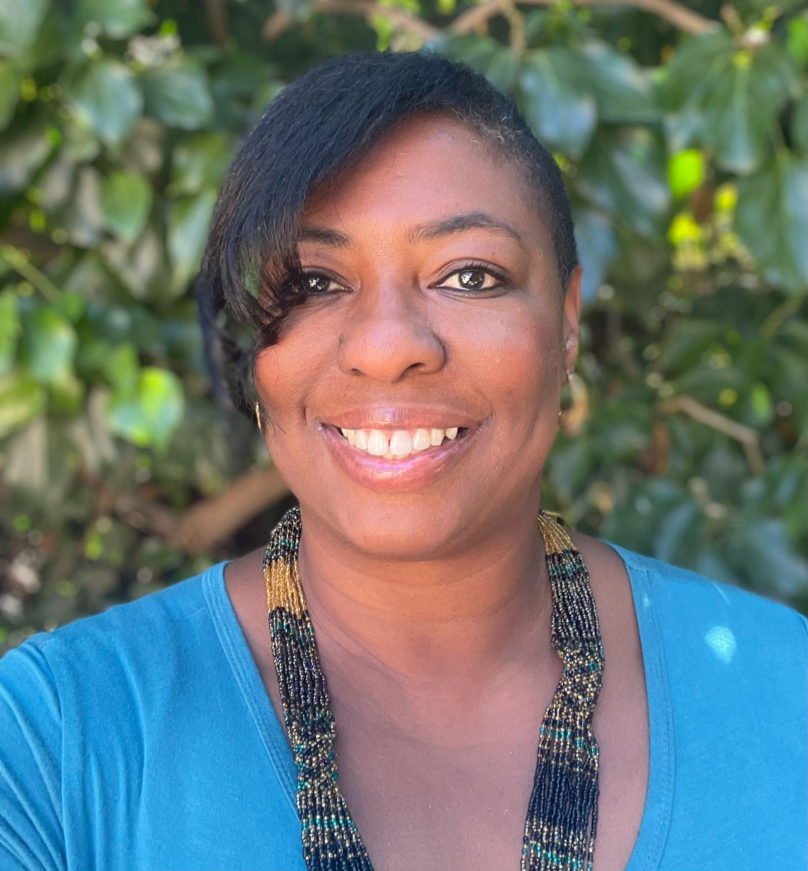
President & CEO
LA Native
Board Member 2016
Curriculum Development 2007
Sustainability & Social Justice
Director of Env. Ed. State of CA
Director, Generation Earth
FRIENDS OF THE LOS ANGELES RIVER | 323.223.0585 | WWW.FOLAR.ORG 570 WEST AVE 26 SUITE 250, LOS ANGELES, CA 90065

Slide 3
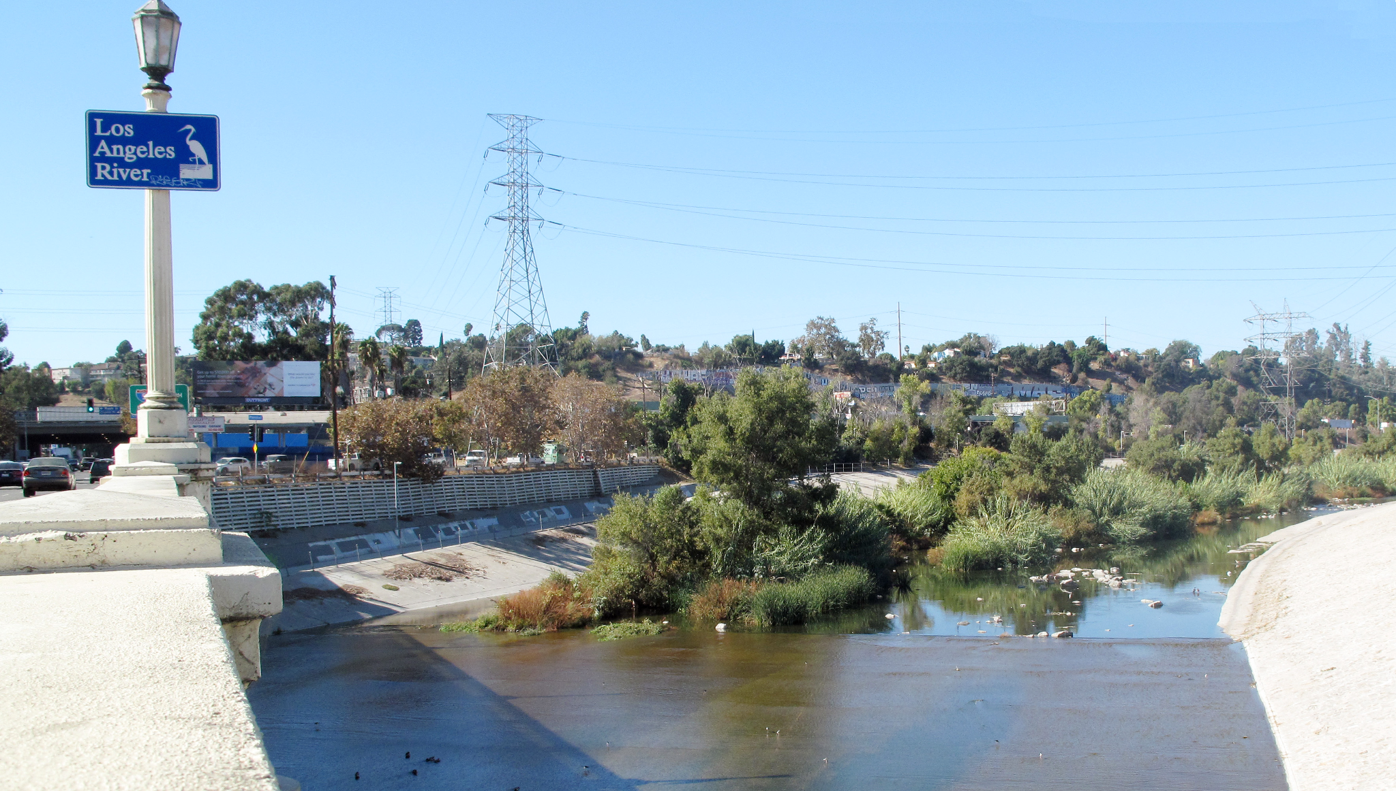
River Community Neighbors
Open Communication
Shared Goals & Collaboration
Community Trust
FRIENDS OF THE LOS ANGELES RIVER | 323.223.0585 | WWW.FOLAR.ORG 570 WEST AVE 26 SUITE 250, LOS ANGELES, CA 90065

Slide 4
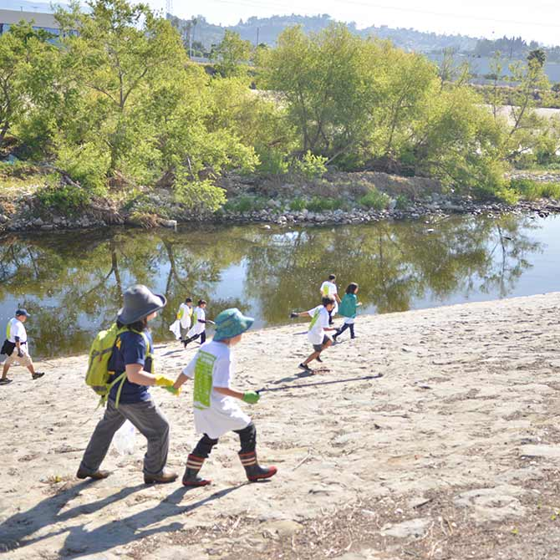
Our Mission
We build capacity for communities, students, and future leaders to advocate for nature, climate, and equity on the Los Angeles River.
FRIENDS OF THE LOS ANGELES RIVER | 323.223.0585 | WWW.FOLAR.ORG 570 WEST AVE 26 SUITE 250, LOS ANGELES, CA 90065

Slide 5
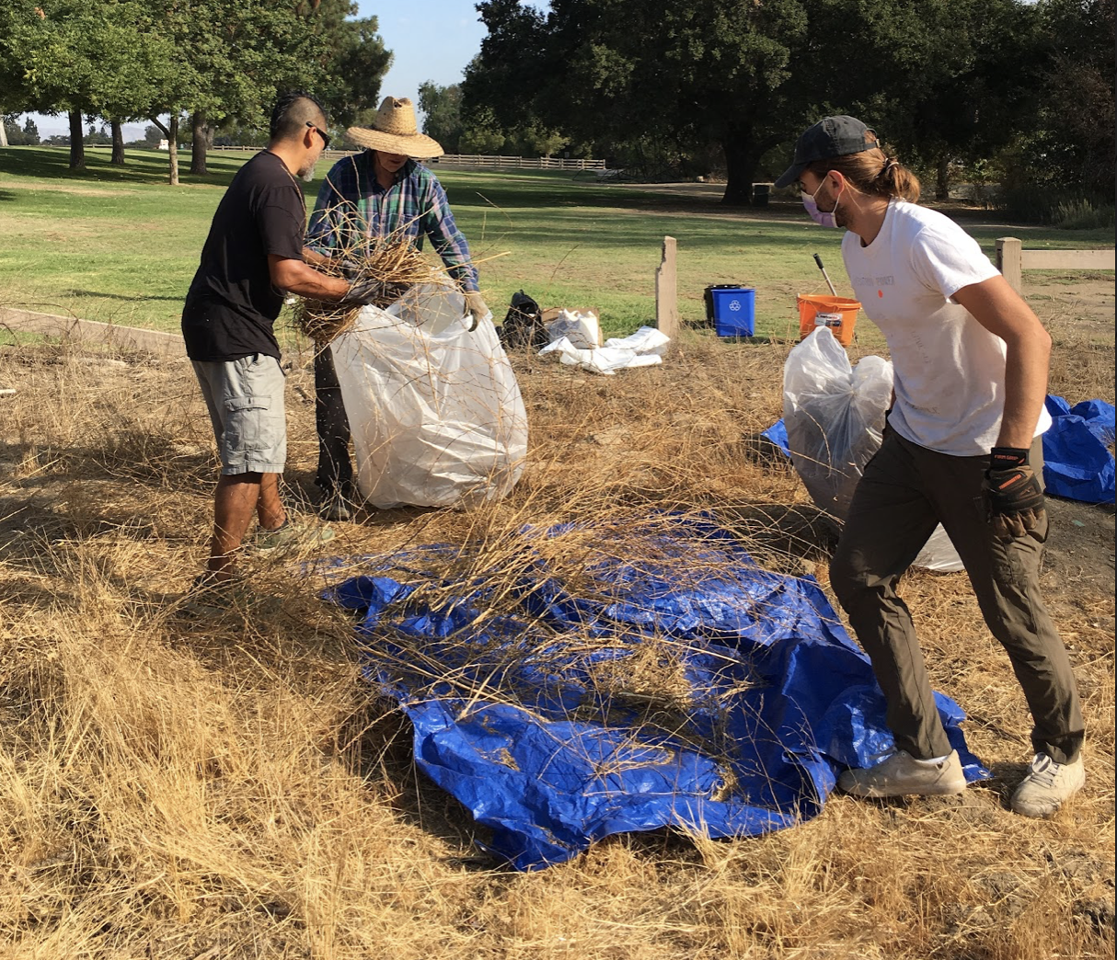
Our Vision
We envision a verdant Los Angeles River that supports vulnerable communities in climate adaptation. The river will be transformed into a dynamic, functioning ecosystem that reduces flood risk, cleans the air, cools temperatures, and supports the biodiversity essential to our collective wellbeing.
FRIENDS OF THE LOS ANGELES RIVER | 323.223.0585 | WWW.FOLAR.ORG 570 WEST AVE 26 SUITE 250, LOS ANGELES, CA 90065

Slide 6
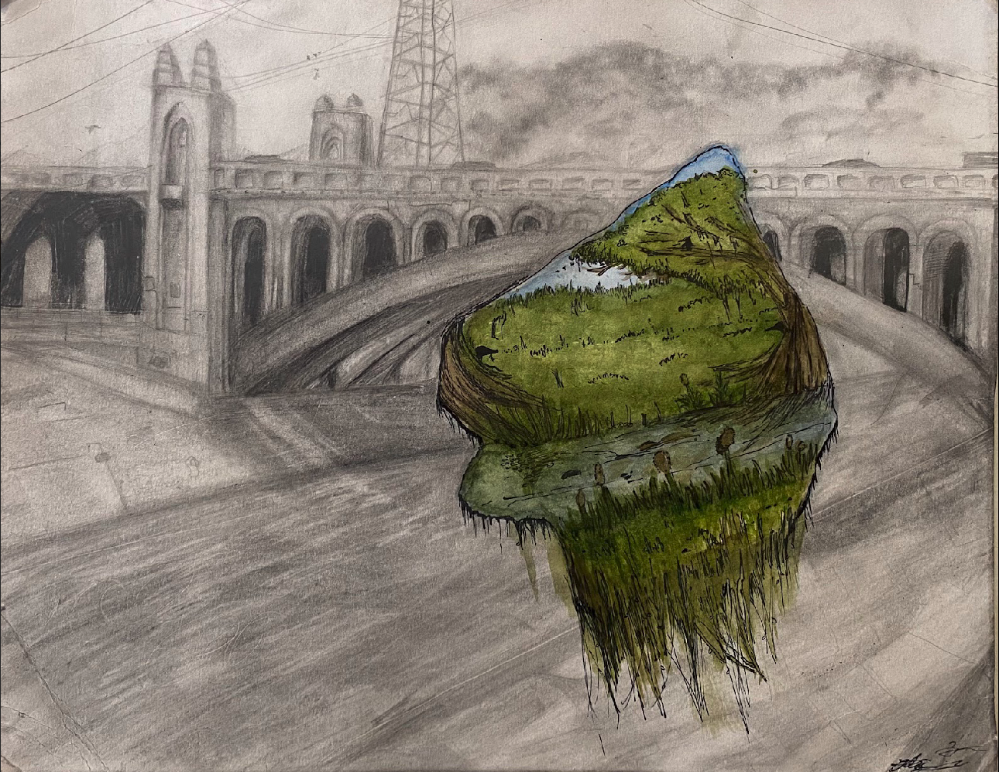
“Golden Years”
The Los Angeles River was a primary source of life for the native Tongva and settlers coming from elsewhere. As the river flooded the surrounding neighborhoods in the 30’s, the solution was to create concrete barriers along the river, which stripped remaining wildlife. Today, the river stands as an inconvenience to the people of LA, whom many aren’t aware of the biodiversity that exists on the riverbank of FrogTown and Atwater Village. I truly wish to see the LA river become what it used to be, a thriving hub for plants, wildlife, and humans.
Notes:
We value youth, artists, and community voice

Slide 7
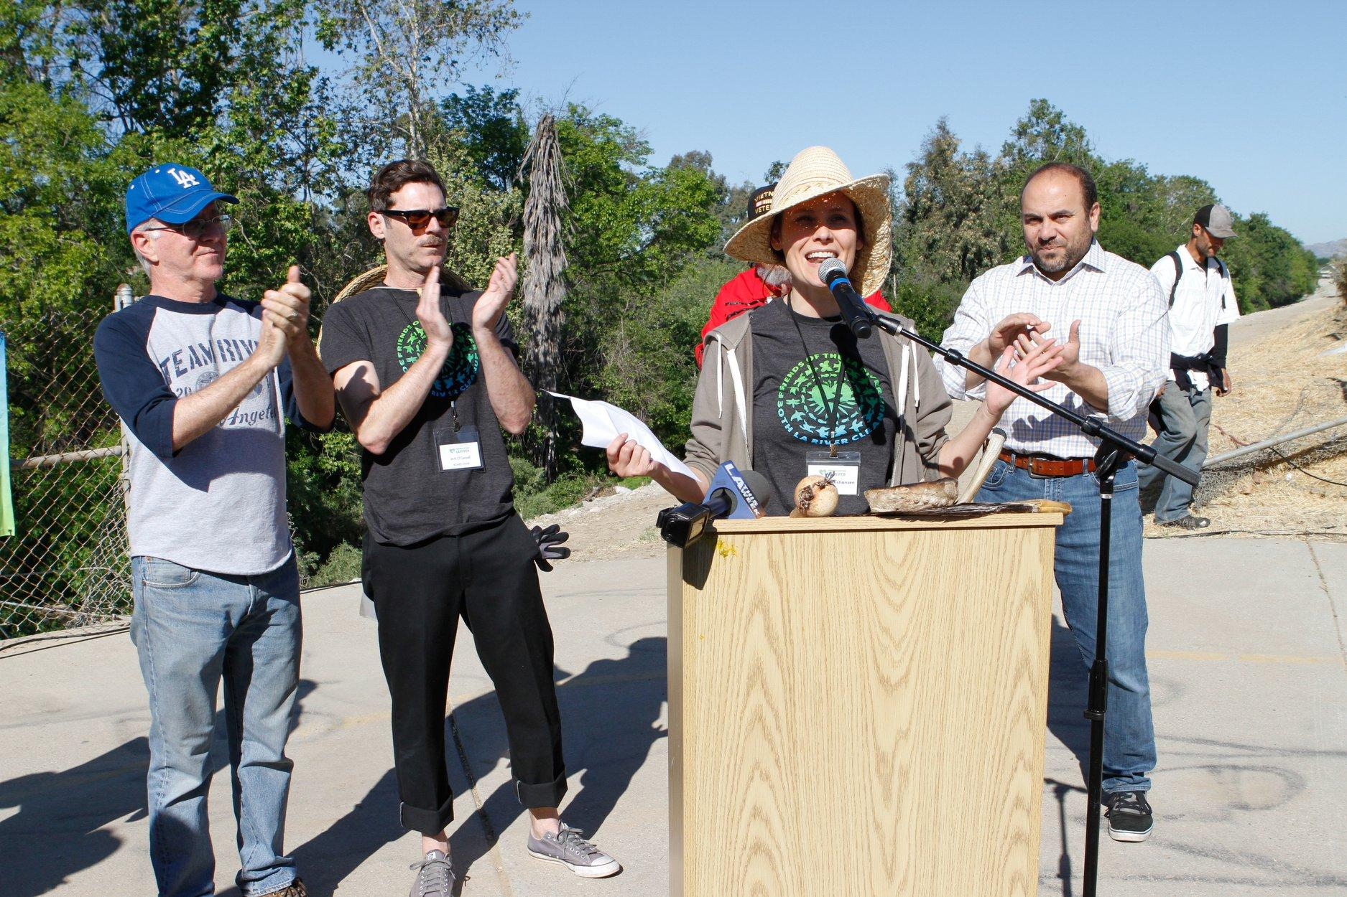
What We Do
Advocate
Equity
Educate
Activate
FRIENDS OF THE LOS ANGELES RIVER | 323.223.0585 | WWW.FOLAR.ORG 570 WEST AVE 26 SUITE 250, LOS ANGELES, CA 90065

Slide 8
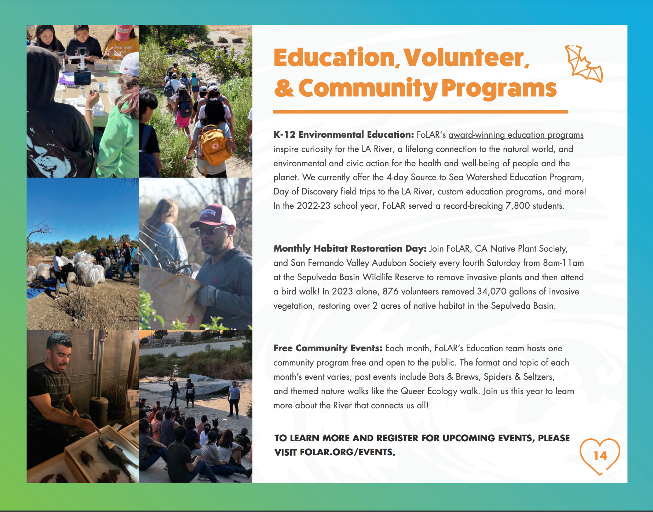
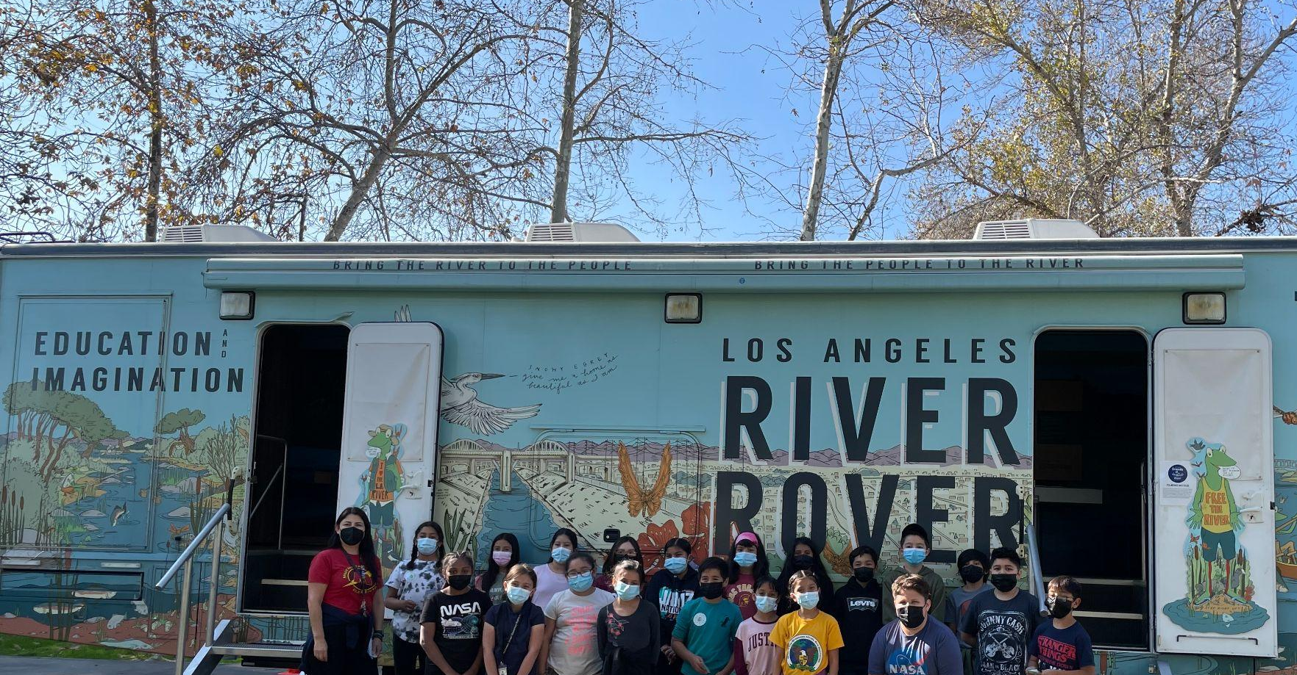
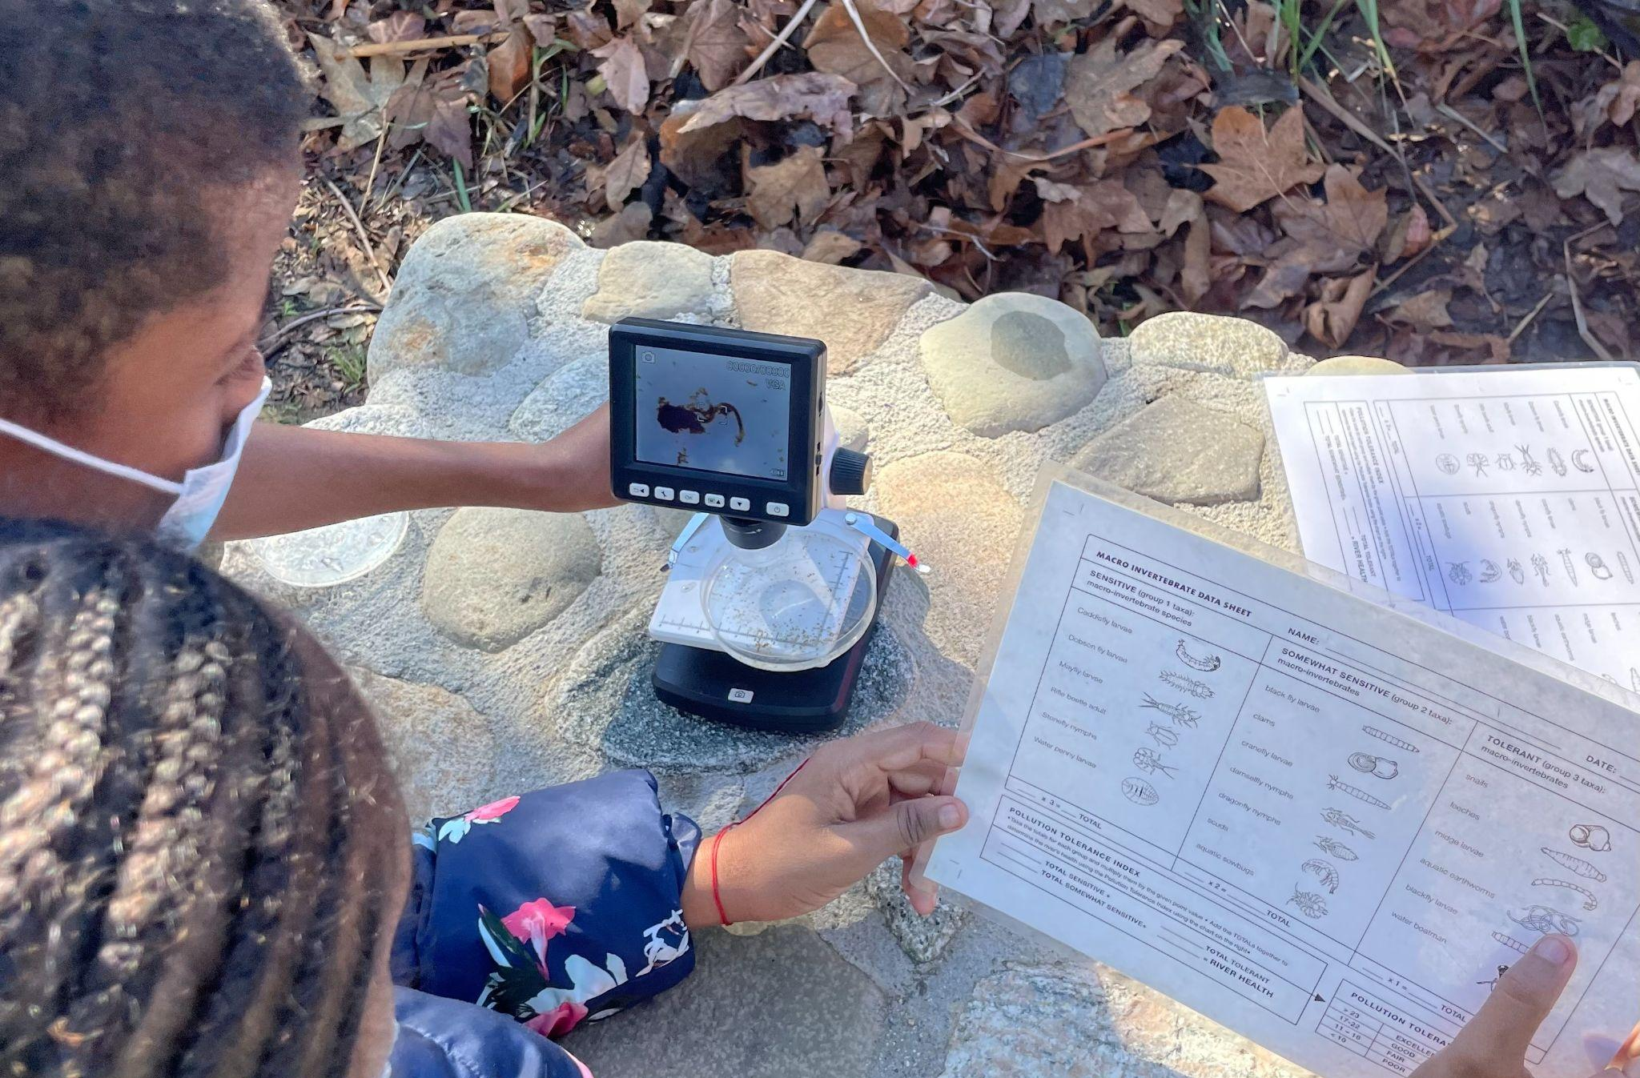
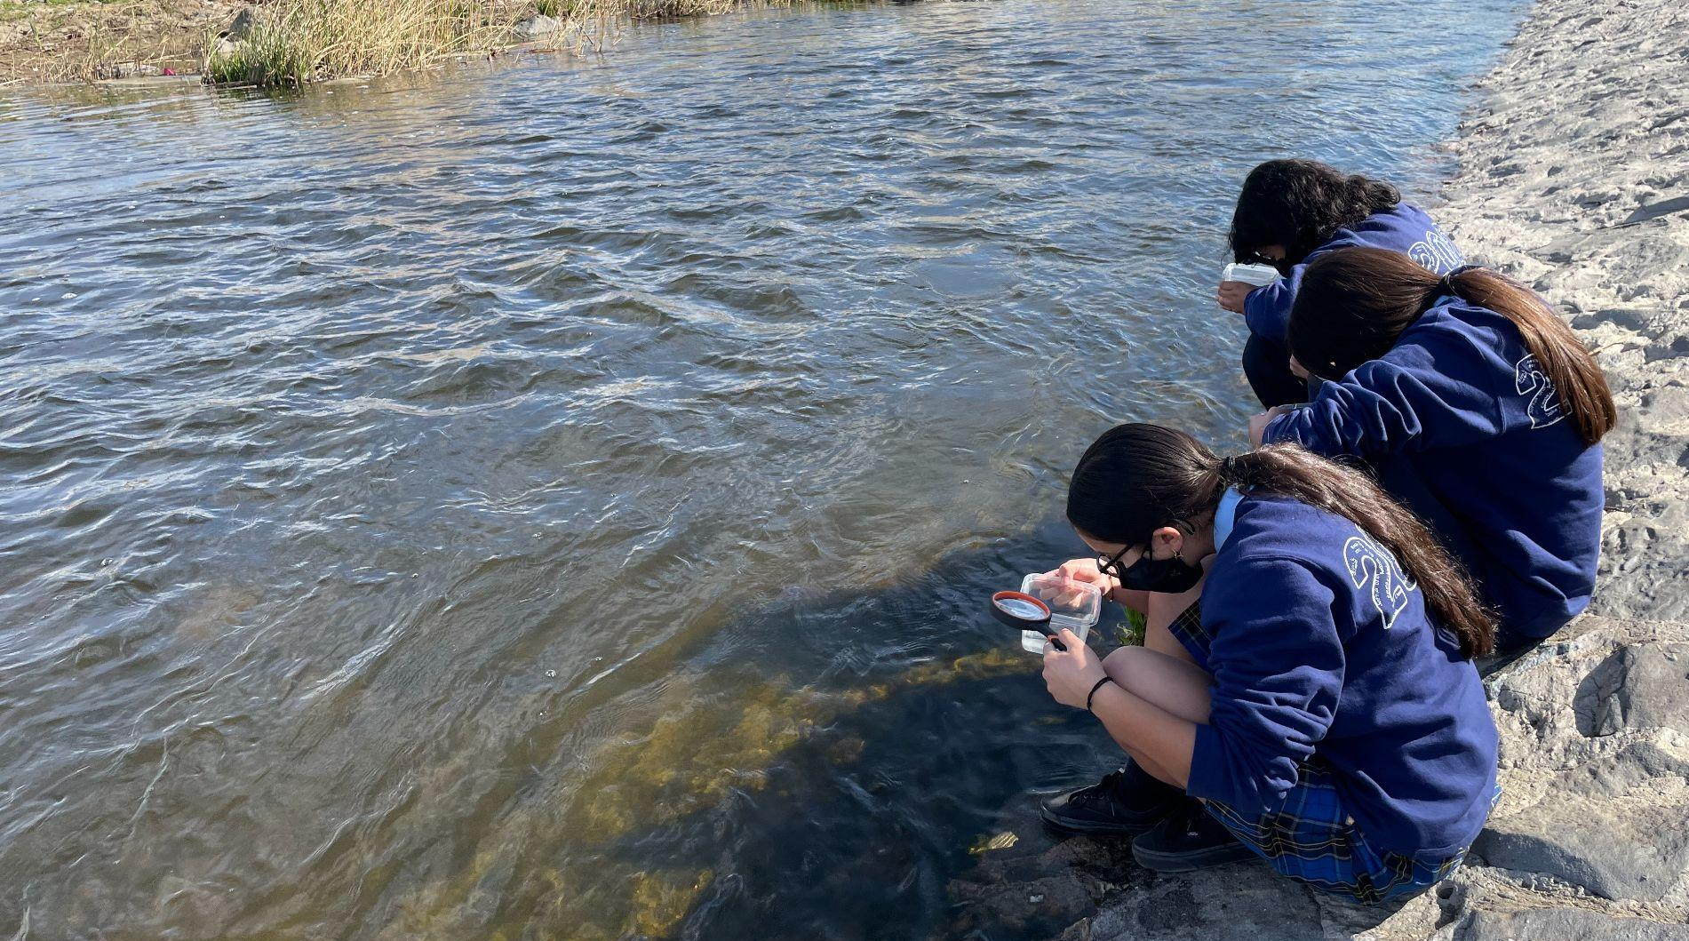
Educate
FoLAR education programs provide life-changing educational experiences that inspire curiosity for the LA River, a lifelong connection to the natural world, and environmental and civic action for the health and wellbeing of people and the planet. `
FRIENDS OF THE LOS ANGELES RIVER | 323.223.0585 | WWW.FOLAR.ORG 570 WEST AVE 26 SUITE 250, LOS ANGELES, CA 90065

Slide 9
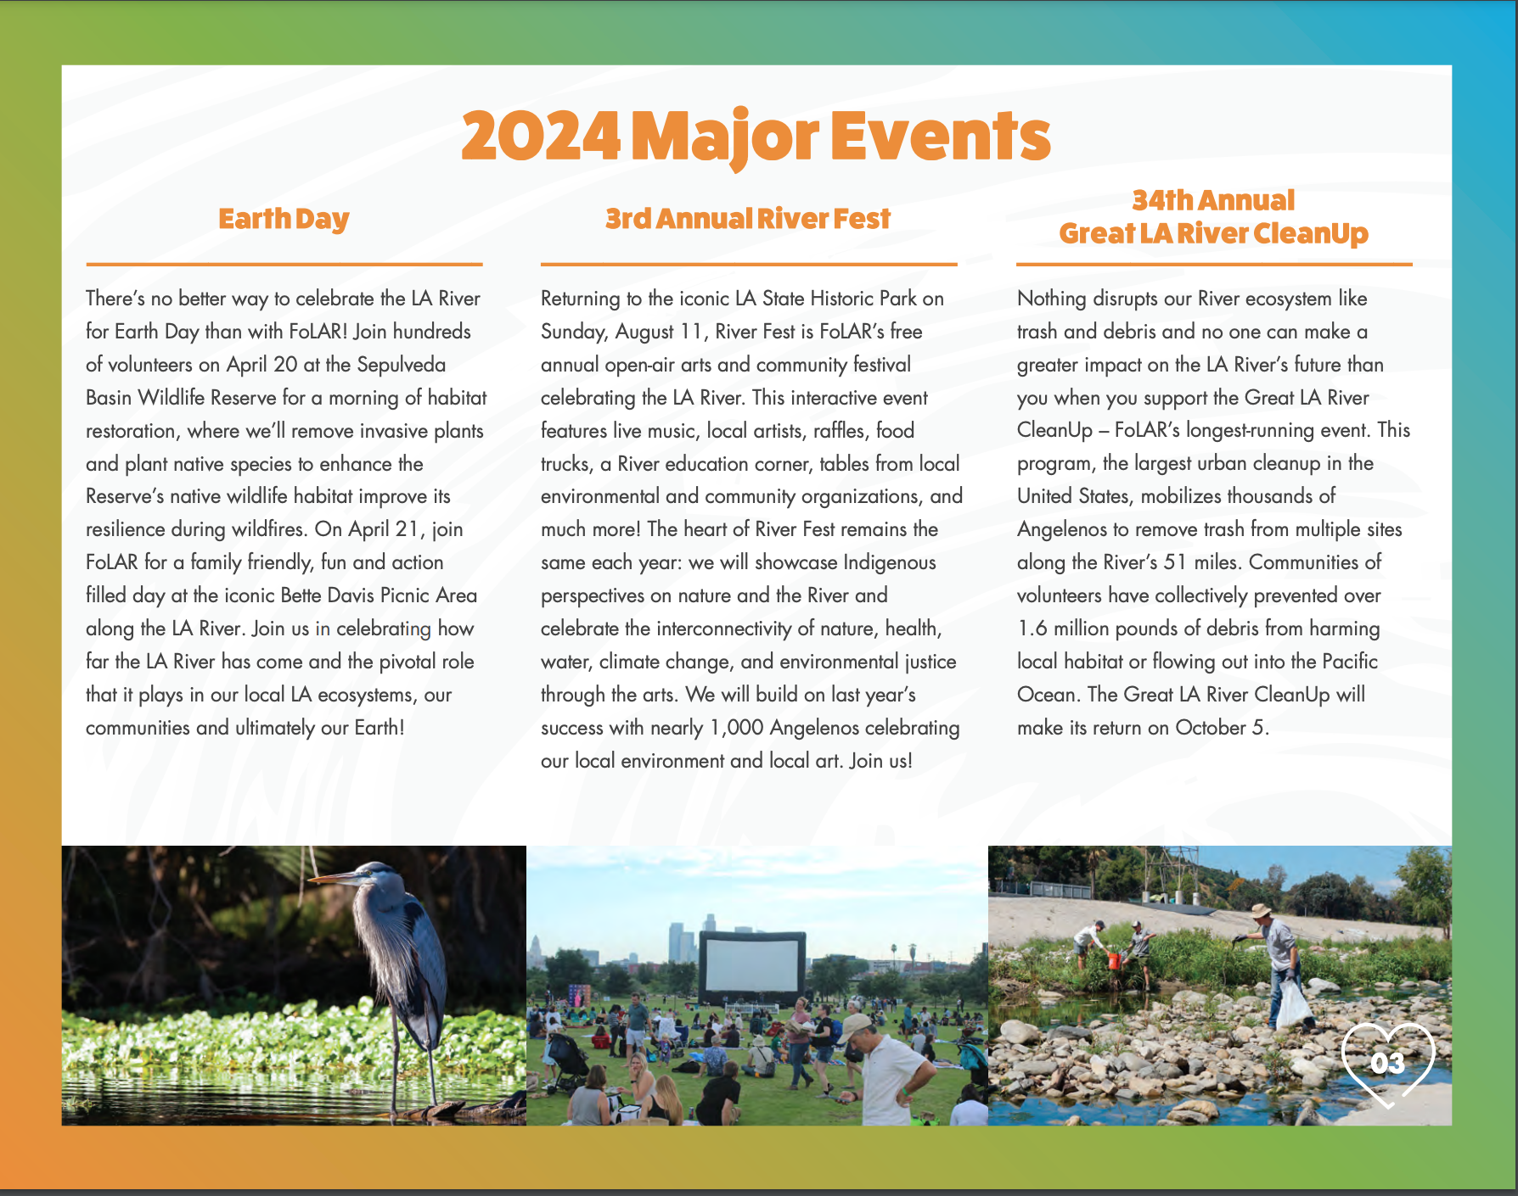
Earth Day
April 20 & 21
River Fest
August 11
Clean Up
October 5
FRIENDS OF THE LOS ANGELES RIVER | 323.223.0585 | WWW.FOLAR.ORG 570 WEST AVE 26 SUITE 250, LOS ANGELES, CA 90065
Notes:
Each year FoLAR’s Great LA River CleanUp brings together thousands of volunteers in service of our great Los Angeles River. What began with ten people at one site in 1989, has grown over 30 years to an effort mobilizing thousands of Angelenos of all ages and backgrounds to make a hands-on, immediate impact on our River’s health at sites all along the River’s 51 miles.

Slide 10
Questions?
FRIENDS OF THE LOS ANGELES RIVER | 323.223.0585 | WWW.FOLAR.ORG 570 WEST AVE 26 SUITE 250, LOS ANGELES, CA 90065

